Slide 1


TN-IMPACT 2026
IDENTIFYING INDUSTRIAL CHALLENGES
PROBLEM STATEMENT NUMBER : TNI126038
PROBLEM STATEMENT TITLE : CREATE A LOW-CODE/NO-CODE
MSMEs TO DIGITIZE THEIR OPERATIONS.

Slide 2
Team details
Team Name : THE TECHERS
College Mentor Name : NARENDARAN M
College Name: SONA COLLEGE OF TECHNOLOGY,SALEM
S.NO | STUDENT NAME | SEMESTER | DEPARTMENT
1 | NITHYAA SHREE S | II | B.TECH CBE
2 | ARSHATH RAHAMAAN KAR | II | B.E.CSE
3 | HARI EASWAR V | II | B.E.CSE

Slide 3
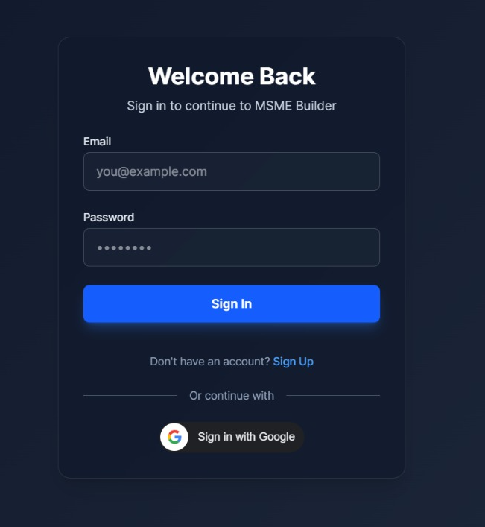
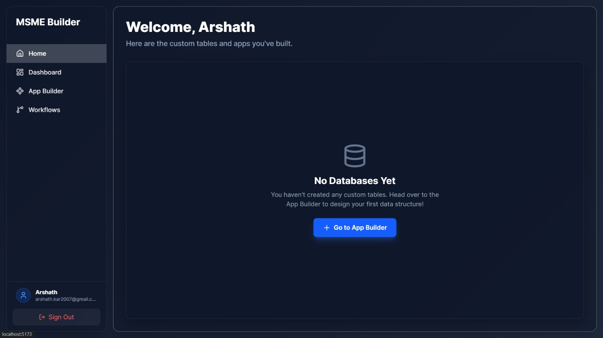
Problem statement
To develop a simple and affordable low-code platform that helps Micro, Small and Medium Enterprises (MSMEs) create and manage their own business applications such as billing, inventory, employee records, and customer management without needing programming skills.

Slide 4
Problem description
MSMEs play a major role in economic growth, employment, and local business development. However, many small business owners still use manual methods like notebooks, spreadsheets, or basic tools to manage their daily operations. This leads to errors, data loss, poor tracking, and reduced efficiency.
Most available software solutions in the market are either too costly, too complex, or designed for large companies. Small businesses often do not have the technical knowledge, time, or budget to use such advanced systems. As a result, they struggle with digital transformation.
There is a clear need for a simple, customizable, and low-cost digital platform that allows MSMEs to easily build their own business tools without coding. MSME Builder solves this problem by offering a low-code platform with drag-and-drop features, ready-made templates, and easy dashboards that help business owners manage their work digitally in a smart and efficient way.

Slide 5
Objectives
Digital Adoption
Affordability
Scalability
Drag-and-Drop Components
Real-time Insights
Data Management
Paperwork Reduction
Goals of the Low-Code Platform

Slide 6
Findings
During research, it was observed that many MSMEs face difficulties in using complex business software due to lack of technical skills and high implementation costs. Most small business owners prefer solutions that are easy to use, low-cost, and time-saving.
Studies and surveys show that digital tools can increase productivity, improve record management, and support better decision-making. A low-code platform significantly reduces development time and allows non-technical users to create customized applications based on their business needs.
User analysis indicates that features like simple UI, mobile accessibility, and automation can greatly improve operational efficiency in small businesses.

Slide 7
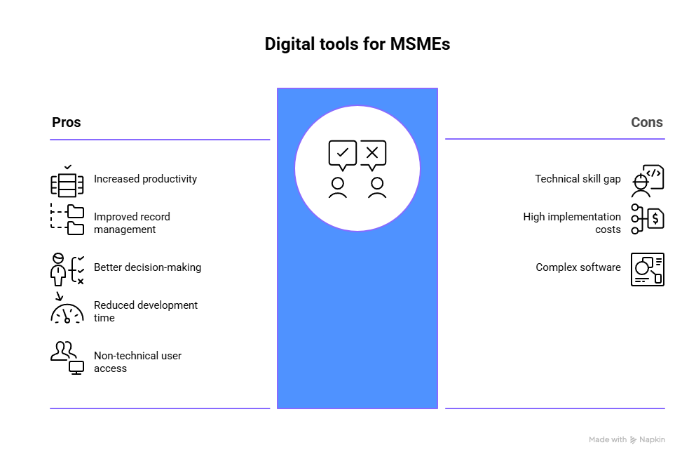

Slide 8
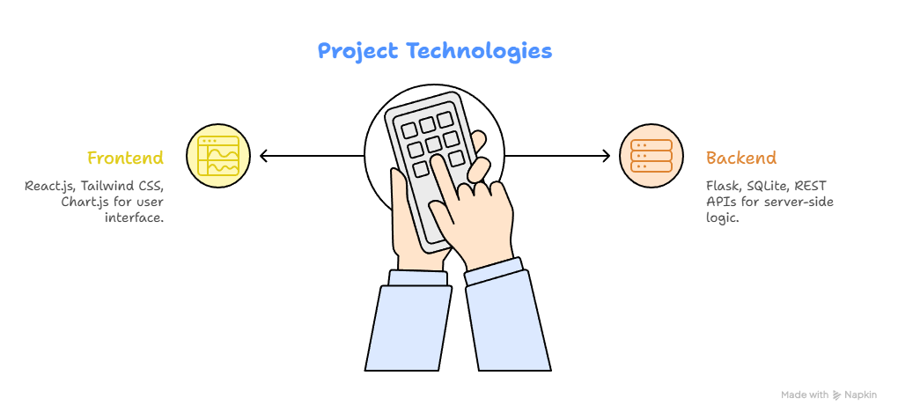
Project Technology

Slide 9
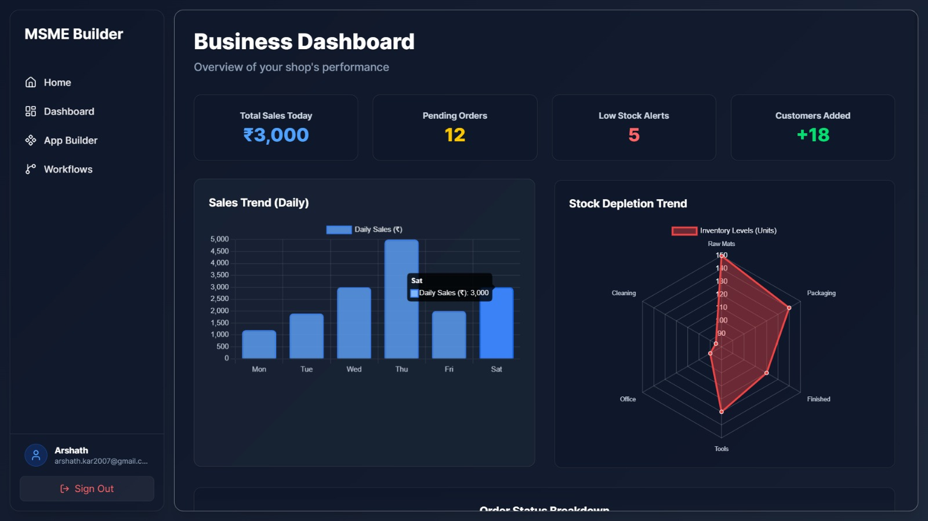
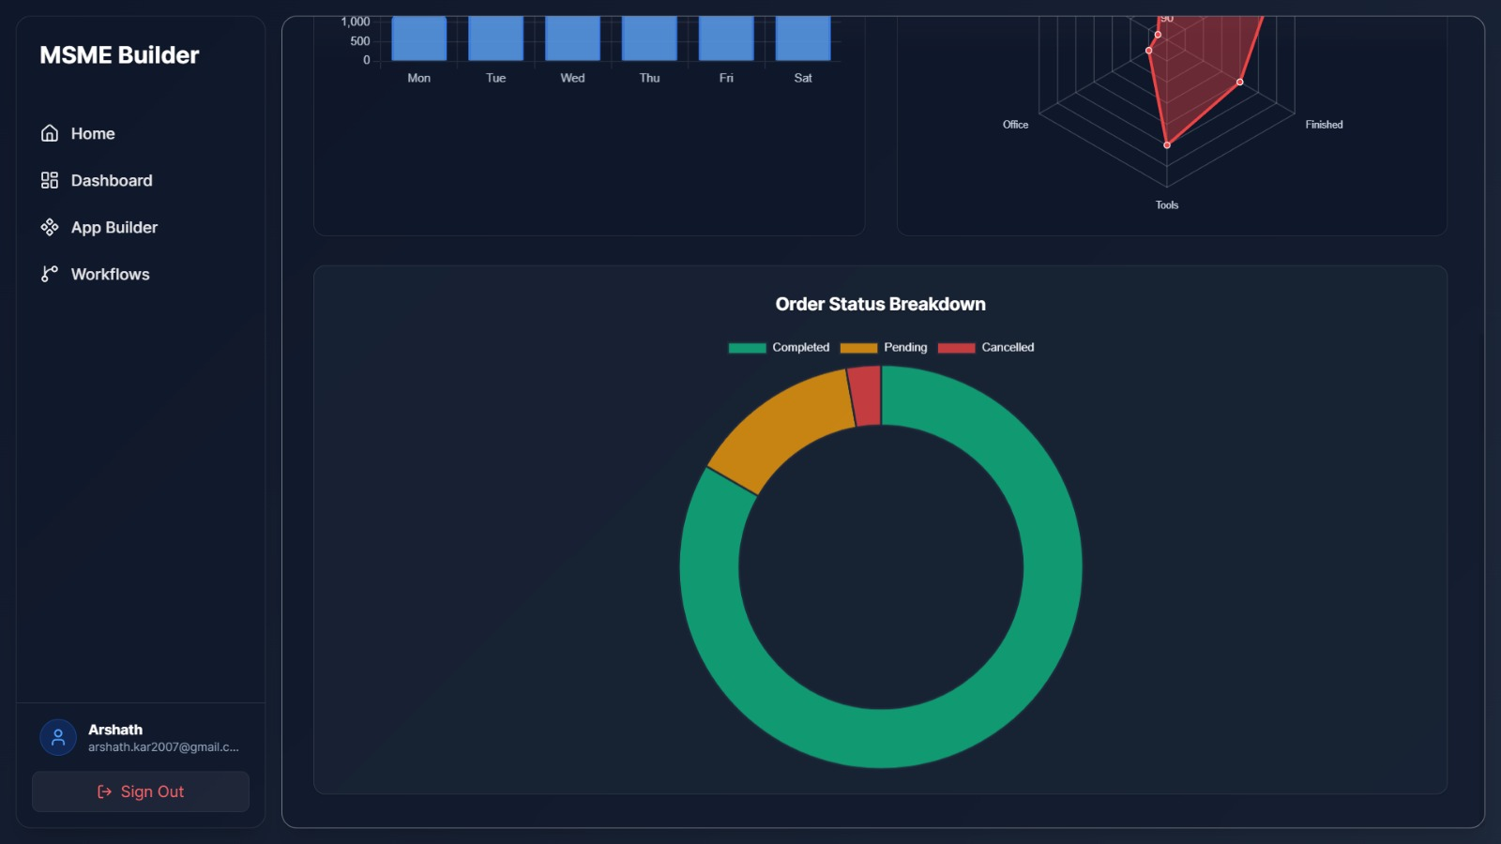

Business Dashboard

Slide 10
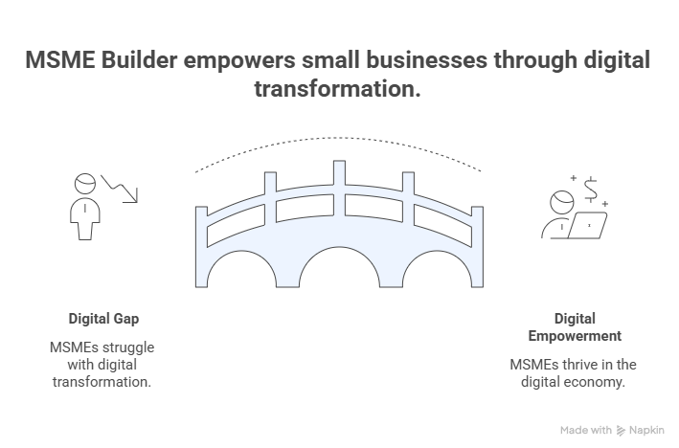

Slide 11
Conclusion
MSME Builder is an innovative, scalable, and cost-effective low-code platform that empowers small businesses to digitize their operations with ease. By eliminating the need for advanced coding skills, the platform enables MSMEs to create customized business applications quickly and efficiently.
This solution enhances productivity, improves data management, and supports sustainable growth of small enterprises. It also aligns with the vision of digital transformation and economic empowerment of MSMEs, making it highly impactful for industrial and societal development.

